Slide 1

Embedded C
Mohamed Saied

Slide 2
Contents
Preprocessor (Macros,Pragma,guard conditions)
Bit Math (Bitwise set bit, clear bit , toggle , shift and rotate)
Type Qualifiers (Const , Volatile)
Compiler Optimization
Enum
STD Types
Design Concepts
Layered Architecture
Startup and Finalizing code
Startup vs Bootloader

Slide 3
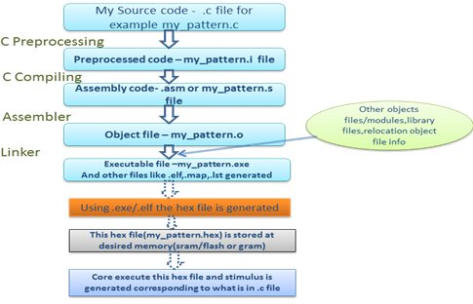
Build Process

Slide 4
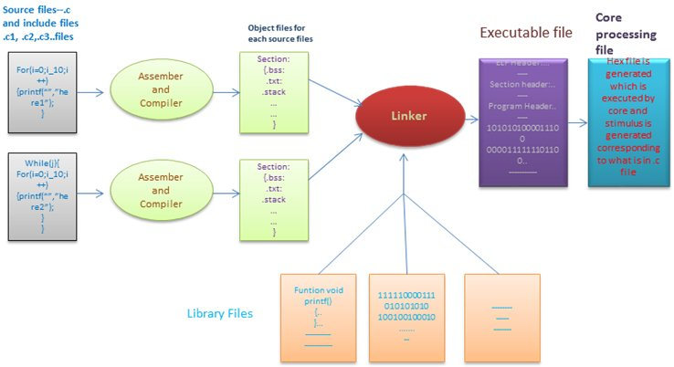
Build Process more details

Slide 5
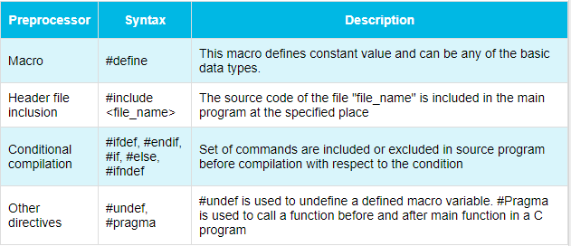
C preprocessor directives
Macro substitution directives. example: #define
File inclusion directives. example: #include
Conditional compilation directive. example: #if, #else, #ifdef, #undef
Miscellaneous directive. example: #error, #line

Slide 6
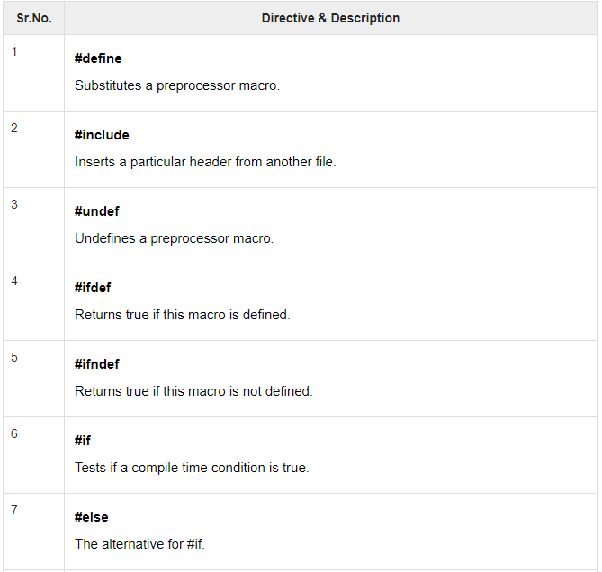
C Preprocessor
We'll refer to the C Preprocessor as CPP.
Preprocessors Examples
Analyze the following examples to understand various directives.
#define MAX_ARRAY_LENGTH 20
This directive tells the CPP to replace instances of MAX_ARRAY_LENGTH with 20. Use #define for constants to increase readability.
#include <stdio.h>
#include "myheader.h"
These directives tell the CPP to get stdio.h from System Libraries and add the text to the current source file. The next line tells CPP to get myheader.h from the local directory and add the content to the current source file.
#undef FILE_SIZE
#define FILE_SIZE 42
It tells the CPP to undefine existing FILE_SIZE and define it as 42.

Slide 7
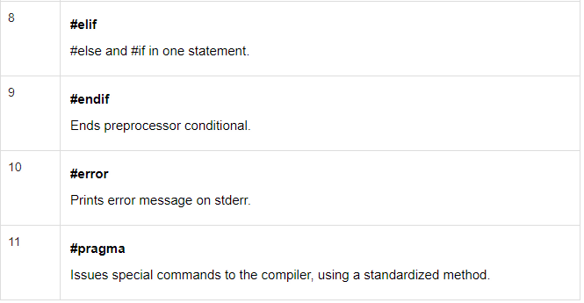
C Preprocessor
#ifndef MESSAGE
#define MESSAGE "You wish!"
#endif
It tells the CPP to define MESSAGE
only if MESSAGE isn't already defined.
#ifdef DEBUG /* Your debugging statements here */
#endif

Slide 8
Object Files
The important fields of object file are :
.text :This section contains the executable instruction codes and is shared among every process running the same binary. This section usually has READ and EXECUTE permissions only. This section is the one most affected by optimization.
.bss: BSS stands for ‘Block Started by Symbol’. It holds un-initialized global and static variables. Since the BSS only holds variables that don't have any values yet, it doesn't actually need to store the image of these variables. The size that BSS will require at runtime is recorded in the object file, but the BSS (unlike the data section) doesn't take up any actual space in the object file.

Slide 9
Object file contents
.data: Contains the initialized global and static variables and their values. It is usually the largest part of the executable. It usually has READ/WRITE permissions.
.reloc: Stores the information required for relocating the image while loading.

Slide 10
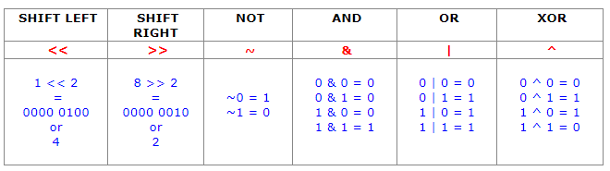
Bit Math

Slide 11
Commonly used Bitwise Operations
Operate on Bit Vectors
Operations applied bitwise
All of the Properties of Boolean Algebra Apply
01101001
& 01010101
01000001
01101001
| 01010101
01111101
01101001
^ 01010101
00111100
~ 01010101
10101010
01000001
01111101
00111100
10101010

Slide 12
MASKING
Bit Masking is used to get value of a specific bit
It’s used as following:
x = 64; y = x & 0b00101000; // y = 0 if 5th or 7th bits are not true, and y>0 if one or both are true
Mathematically here is what we did above:
0100 0000 x (set to 64 on the first line) & 0010 1000 mask (created with 0b00101000 on the second line) ---------- 0000 0000 result, loaded into y

Slide 13
Bit Masking (Example)
x = 64; y = x & ( (1<<5) | (1<<3) );
Mathematically here is what we did: Solve the brackets:
(1 << 3) creates 0000 0001 shift it left by 3 to get 0000 1000 (1 << 5) create 0000 0001 shift it left by 5 to get 0010 0000 Rearranged to solve the ( (1<<5) | (1<<3) ) part of the equation:
0000 1000 (1 << 3) | 0010 0000 (1 << 5) ------------- 0010 1000 notice that we just created 0b00101000
Substitute: y = x & 0010 1000
Now rearrange to solve: 0100 0000 x (set to 64 on the first line) & 0010 1000 mask (created with ( ((1<<5) | (1<<3)) ) ---------- 0000 0000 result, loaded into y
PUTTING IT ALL TOGETHER: y = 64; y |= (1<<3); Expand:
y = y | (1 << 3)
Solve the brackets:
(1 << 3) creates 0000 0001 shift it left by 3 to get a 0000 1000
Substitute: y = y | 0000 1000
And finally rearrange to solve:
0100 0000 y (set to 64 on the first line) | 0000 1000 mask (created with (1<<3) ) ---------- 0100 1000 result, loaded into y

Slide 14
LAB BITWISE
Create a header file that provide the equations of bit wise operations as macros
For example:
SET_BIT(REG,BIT) REG|=(1<<BIT)
GET_BIT(REG,BIT) ((REG>>BIT) & 1)
CLR_BIT(REG,BIT) REG&=~(1<<BIT)
TOGGLE_BIT(REG,BIT) REG^=(1<<BIT)

Slide 15
Constant and Volatile Qualifiers
const is used with a data type declaration or definition to specify an unchanging value and its placed in .rodata section in ROM
Examples:
const int five = 5;
const double pi = 3.141593;
const objects may not be changed
The following are illegal:
const int five = 5;
const double pi = 3.141593;
pi = 3.2;
five = 6;

Slide 16
Volatile Qualifier
volatile specifies a variable whose value may be changed by processes outside the current program
One example of a volatile object might be a buffer used to exchange data with an external device:
volatile int iobuf;
Int check_iobuf(void)
{
int val;
while (iobuf == 0) {
}
val = iobuf;
iobuf = 0;
return(val);
}
if iobuf had not been declared volatile, the compiler would notice that nothing happens inside the loop and thus eliminate the loop
const and volatile can be used together
An input-only buffer for an external device could be declared as const volatile (or volatile const, order is not important) to make sure the compiler knows that the variable should not be changed (because it is input-only) and that its value may be altered by processes other than the current program

Slide 17
When to use volatile?
Interview Question
Problems that makes you use volatile
Registers that are modified by hardware
Global variable used inside interrupt
Code that works fine--until you enable compiler optimizations
Code that works fine--until interrupts are enabled
Flaky hardware drivers
RTOS tasks that work fine in isolation--until some other task is spawned
Resources inside task will be needed by another task wont be spawned yet

Slide 18
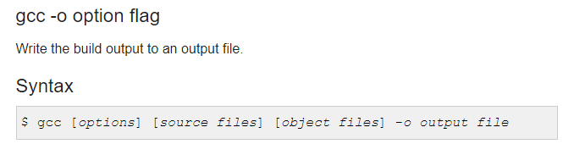
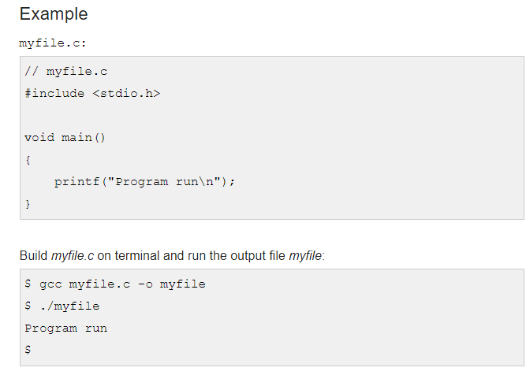
Optimization
GCC Compiler provides an option to optimize the code to reflect :
1) Execution time 2) Code size 3)Memory Usage 4) Compilation times
There are levels of Optimization provided by option flag

Slide 19
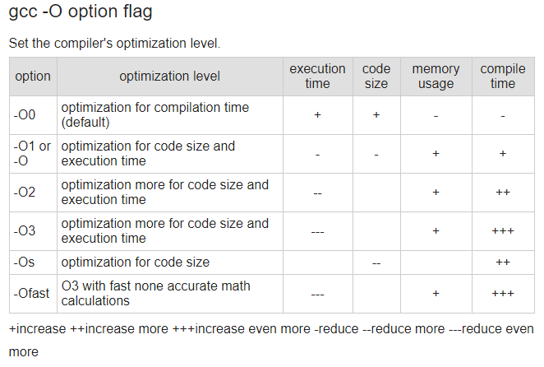
Optimization

Slide 20
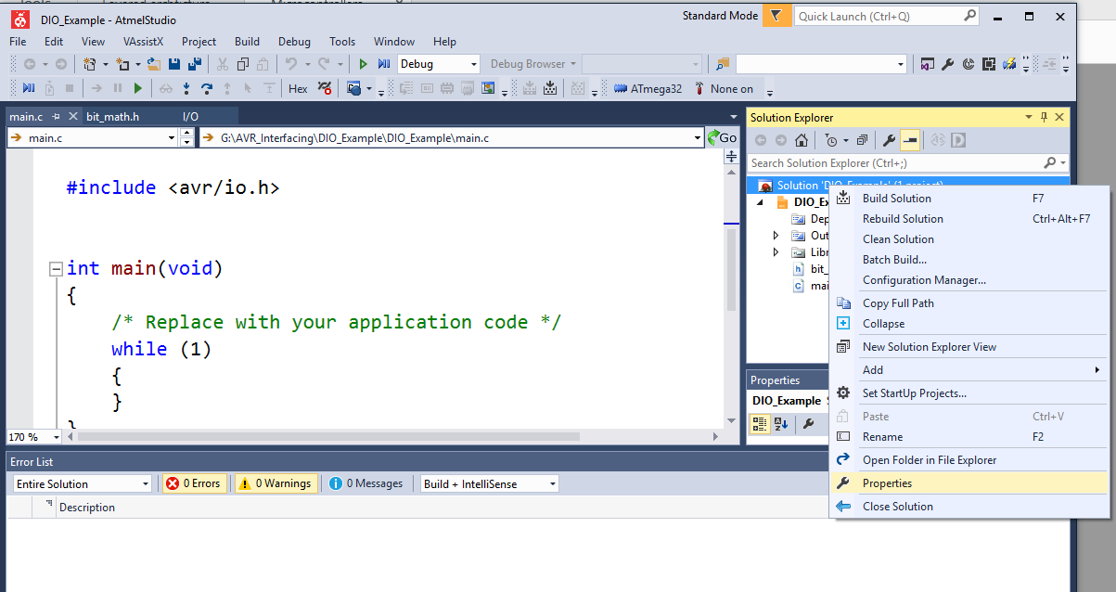

Slide 21
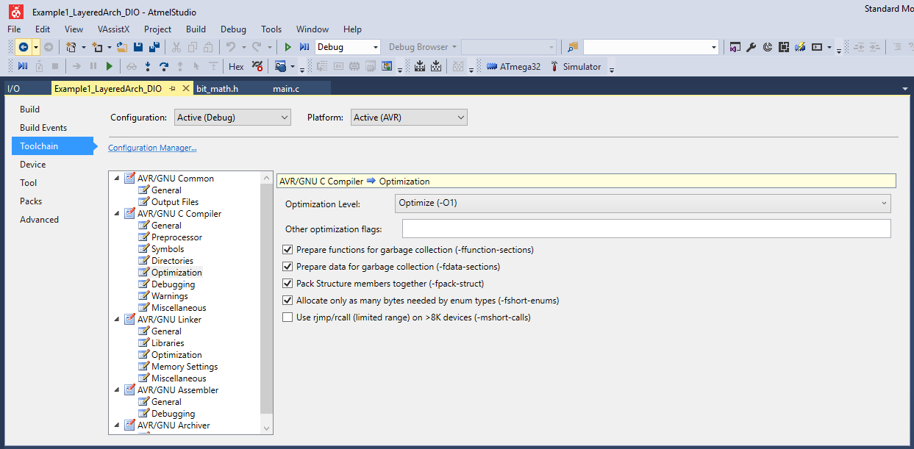

Slide 22
Enum Cont’
The GCC C compiler will allocate enough memory for an enum to hold any of the values that you have declared. So, if your code only uses values below 256, your enum should be 8 bits wide.
If you have even one value that is greater than 255, C will make the enum larger than 8 bits; big enough to hold the biggest number in the enum.
typedef enum
{
Dio_Port_A,
Dio_Port_B,
Dio_Port_C,
Dio_Port_D
}Dio_PortType;

Slide 23
Enum
Enums are a great way to put descriptive names on "magic numbers", unexplained values that litter code and really should be avoided.
Int value=5; //5 is a magic number
The C standard specifies that enums are integers, but it does not specify the size. Once again, that is up to the people who write the compiler. On an 8-bit processor, enums can be 16-bits wide. On a 32-bit processor they can be 32-bits wide or more or less.

Slide 24
typedef
typedef is a keyword used in C language to assign alternative names to existing datatypes. Its mostly used with user defined datatypes, when names of the datatypes become slightly complicated to use in programs.
typedef unsigned char uint8;
typedef unsigned short int uint16;
typedef unsigned long int uint32;
typedef can be used to give a name to user defined data type as well. Lets see its use with structures.
typedef struct { type member1;
type member2;
type member3;
} type_name;
I.V Question
Typedef Vs Macro?

Slide 25
LAB 2
Create a Standard type definitions (STD_Type.h)
uint8 , uint16 and uint32 and other for the signed integer
Also place port and pin standard types using enum

Slide 26
Design Concepts
There are two types of design
Dynamic Design: tells how the system behaves and responses to inputs and events, can be expressed with Data flow diagram, Finite State Machine and others
Example Finite State Machine
Reach target
Check buttons
New Press
Calculate target
Motors on till reach target
Do action

Slide 27
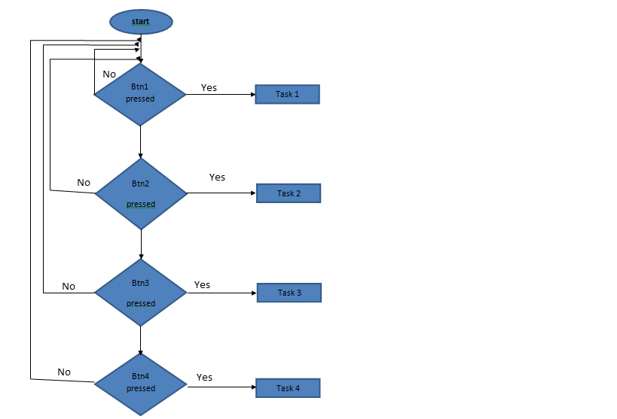
Flow Charts

Slide 28
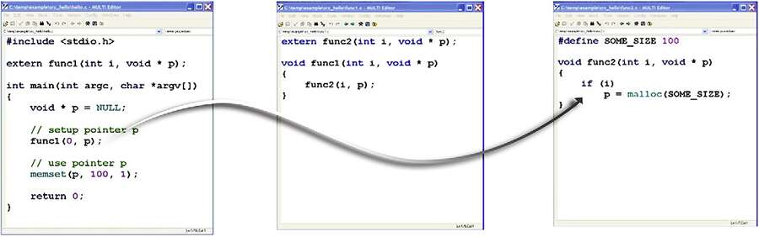
Static Design (Architecture)
Static Design: related to the file structure and functions

Slide 29
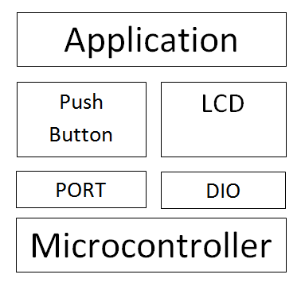
Architecture Design
→Benefits
Maintainable.
Testable.
Easy to assign separate "roles"
Easy to update and enhance layers separately.
Btn.h
Main.h
Lcd.h
File name | FILE DESCRIPTION
main.c | The Entry point for the application.
Main.h | Header file contains functions prototypes ,global variables , config.
LCD.h | Header file contains config for LCD
Btn.h | Header file conatins config for Buttons
Main.c

Slide 30
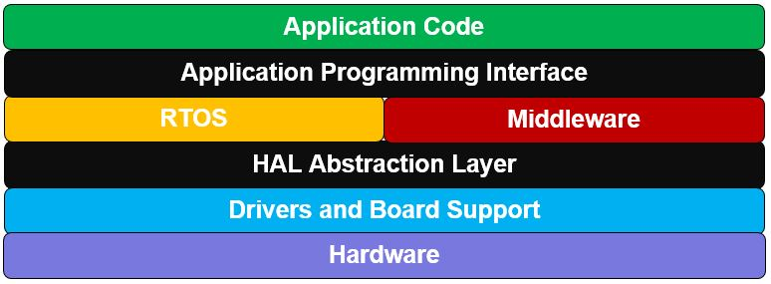
General Layered Arch.
Why Do we need Layered Arch.?
The Idea is to isolate the Hardware Registers from the Application and other layers of code
Give the code more flexibility and reusability
Reduce the complexity during development and integration of various functionalities

Slide 31
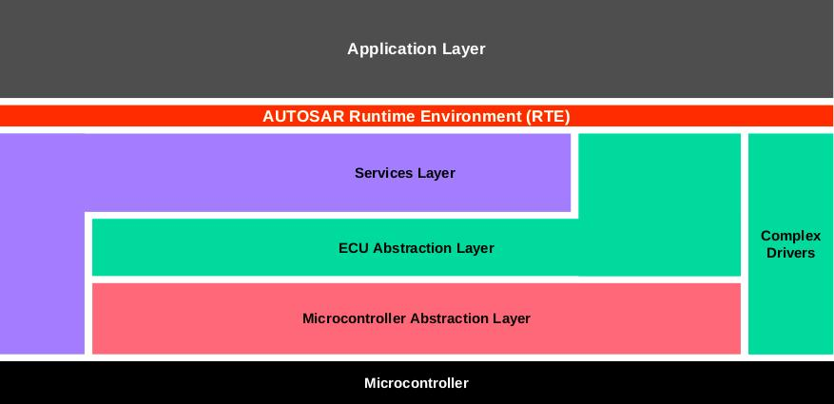
AUTOSAR Basic Architecture

Slide 32
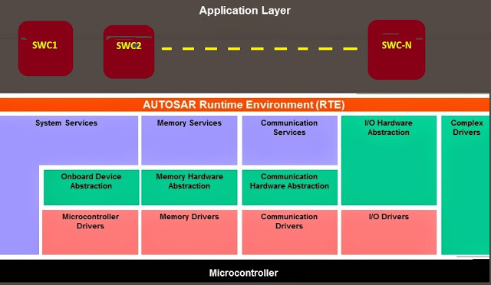
Autosar Basic Architecutre
AUTOSAR Software architecture is broadly classified into 3 categories. They are
1) Basic Software (BSW)
2) Application Software (ASW)
3) Run Time Environment (RTE).

Slide 33
AUTOSAR Stack
The AUTOSAR has made basic software as layered architecture. The layers are
i) MCAL (Microcontroller Abstraction Layer): Which directly access and control the underlying micro-controller and its resources. It abstracts the micro-controller from its upper layers. [That means the details of registers, memory location, if the controller is a BIG ENDIAN or LITTLE ENDIAN etc are hidden from above layer and provides a uniform interface to them to access the below hardware.] ii) ECUAL (ECU Abstraction Layer): Which interacts with MCAL layer for micro-controller access and directly accesses the hardware resources inside the ECU and not inside micro-controller (like external memory chips, external CAN controllers etc). It abstracts the ECU from its upper layers. If the ECU is changed or upgraded then the layers above ECUAL will not be affected.

Slide 34
AUTOSAR Stack
iii) Services Layer: Which provides the services to application layers using which the application software components can utilize the hardware resources. Services layer also includes the operating system. The real time operating system of AUTOSAR is called OSEK. We visualized BSW as layers (horizontal) before. Basic software can also be viewed as stacks (vertical layers) depending on the functionality. For example The software modules for communication (like CAN Flexray, ethernet etc) in each of the layers like MCAL, ECUAL and services can be visualised as stack of software modules for communication. This is called as comstack. Similarly the AUTOSAR can be visualized as group of following stacks: i) Service stack: General services (like I2C SPI etc )provided by BSW to upper layer ii) Comstack: Communication stack for intra-ECU or inter-ECU communication iii) Memstack: Memory stack. Stack of software modules which provide services to access the memory resources of ECU. iv) Diagstack: Diagnosis stack. Stack of software modules which implement the vehicle diagnosis and tester communication and OBD standards. vehicle diagnostics.]
v) IO stack: Input Output Stack. The software modules which control the input pins output pins of ECU, the ADC and other input output related devices present in the ECU.

Slide 35
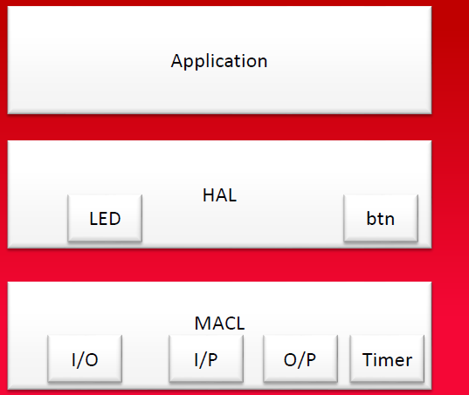
Example
In the Previous Slides we showed what we aim to
Now let’s see how we can start from Ground Up
Create MCAL Layer with DIO and Timer
Create HAL Layer with Buttons and LEDS
Application Code includes the logic which is to ON LED when Button is pressed

Slide 36
references
https://embedded.fm/blog/2016/6/28/how-big-is-an-enum
http://www.keil.com/support/man/docs/armclang_intro/armclang_intro_fnb1472741490155.htm
https://www.rapidtables.com/code/linux/gcc/gcc-o.html
https://www.engineersgarage.com/ezavr/how-to-write-a-simple-bootloader-for-avr-in-c-language-part-35-46/
https://sites.google.com/site/qeewiki/books/avr-guide/advance-bit-math
http://users.ece.utexas.edu/~valvano/Volume1/E-Book/C7_DesignDevelopment.htm
http://www2.phys.canterbury.ac.nz/dept/docs/manuals/unix/DEC_4.0e_Docs/HTML/AQTLTBTE/DOCU_037.HTM
http://erika.tuxfamily.org/wiki/index.php?title=AUTOSAR-like_DIO_Driver
http://techietots101.blogspot.com/

